Slide 1

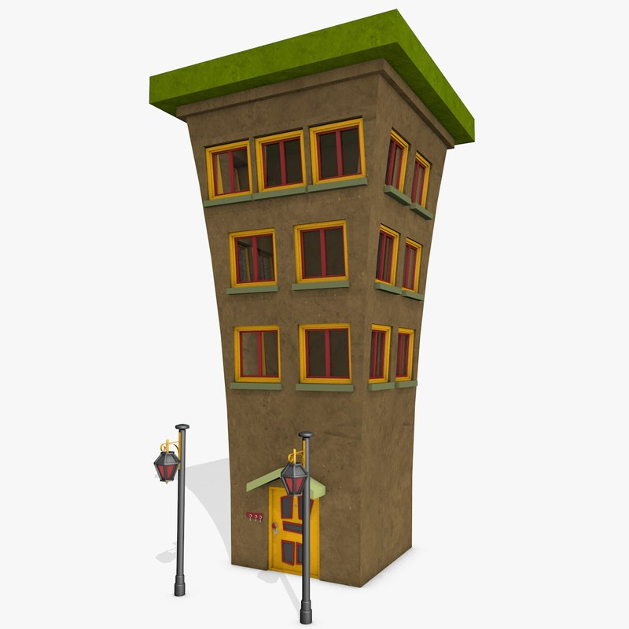
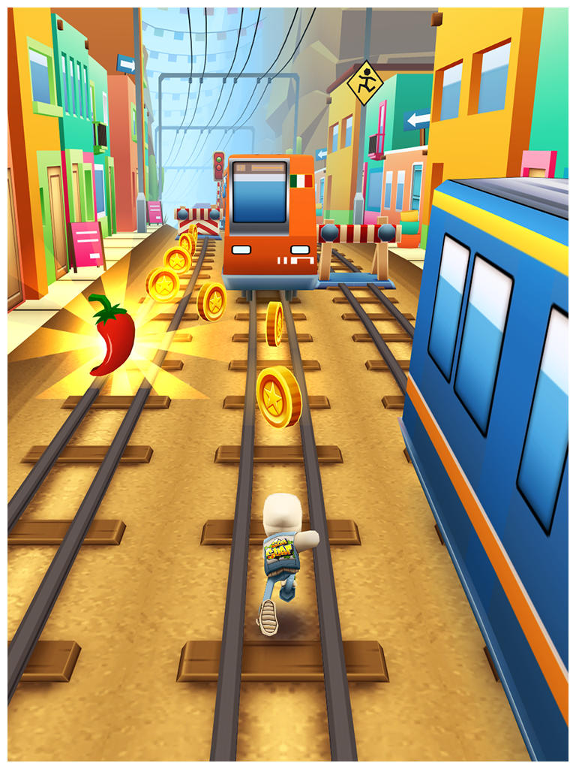
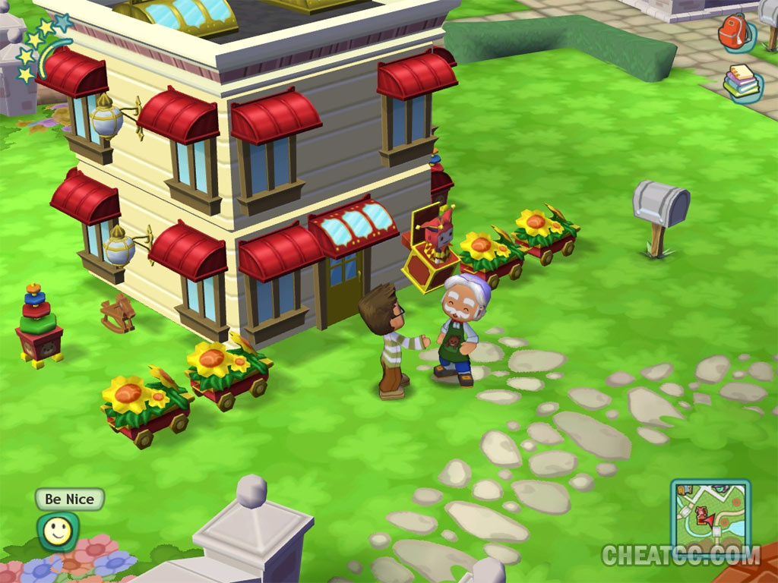

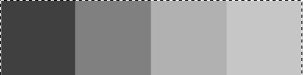


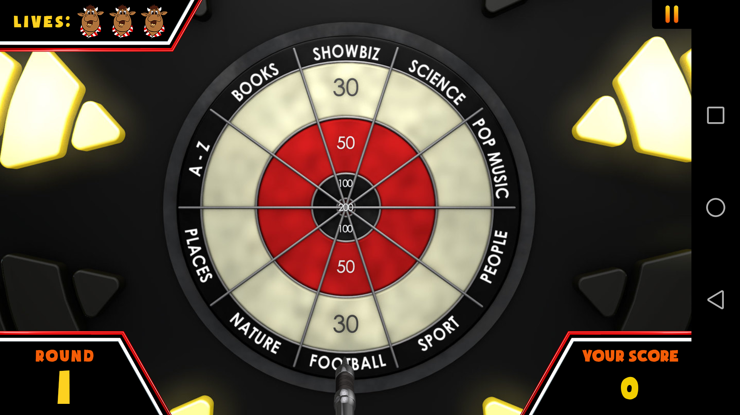
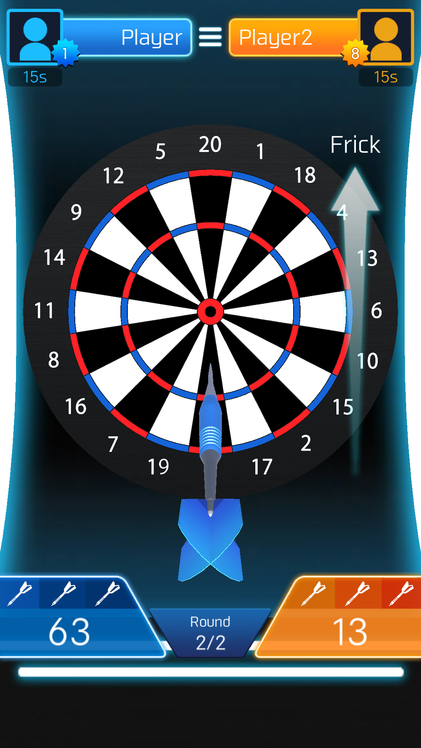
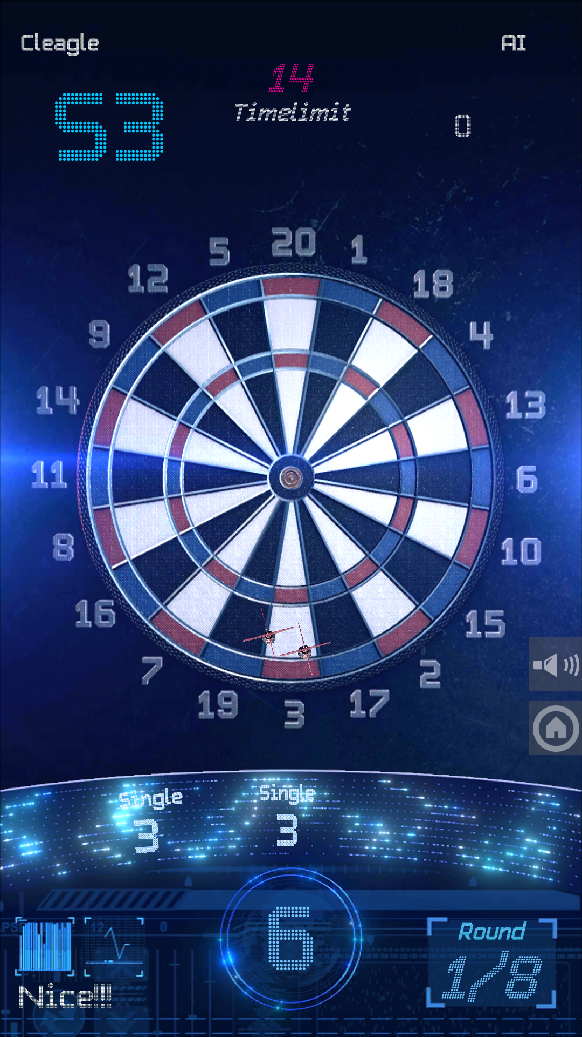



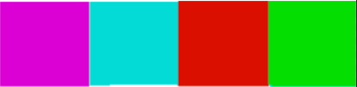
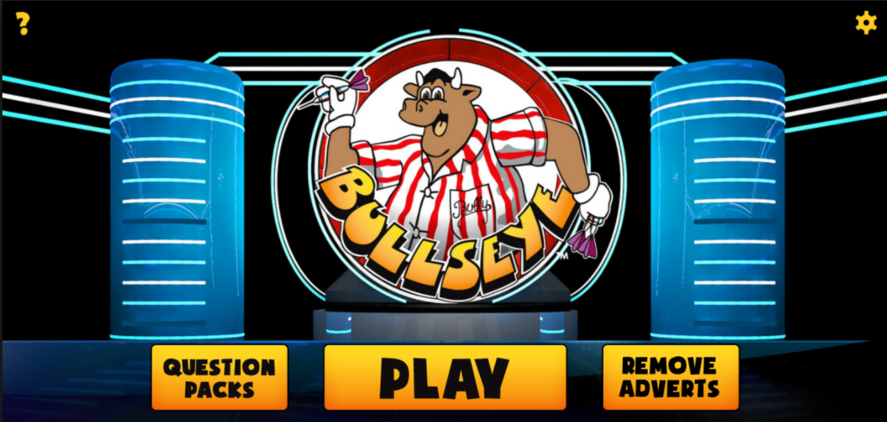
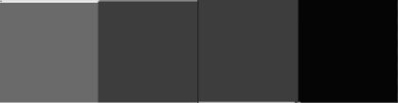

Art
Notes:
Colour Palettes: The palette at the bottom of the slide is what I think the final palette should be, there is a variety of colours that all contrast very well since I’ve changed their values and made them not too high or too low. Also I trued to stick with colours that are similar to a darts board (Red, Black, Green) because that’s what people are used to and they’ll feel comfortable when playing on the board. There’s a few different colours in there as well, this would be for the background or possibly the HUD. I chose these colours because they are kind of like circus colours with red, blue, yellow and purple and so they might make a person more attracted too it because they’re reminded of all the fun they had at circus’ or carnivals. The brighter colours will also work with the possible cartoon art style since both of them together make the game look a lot more casual and easy to play for the target audience.
Art Style: The art style we should use I think should be a cartoon style so that the game doesn’t look like it’s trying to be very serious as a few dart apps that I looked at look too realistic and so don’t give off the casual vibe when playing them or looking at their app page. The only problem with this would be having to make sure that the game isn’t too cartoonish as to give the impression that it’s a kids game. A Good example of what I have in mind is the Bully Darts Game (image on slide) As this has a simple HUD and a cartoon-like art style so that the player can tell it’s not a very serious game and can be played casually. The HUD that they have is also a good example since they keep everything neat without any advertisements or clutter, everything is out of the way of the board, making it easy to throw the dart.
Optional Art Style: I also think a good possibly art style would be to have the futuristic/technology type board and background as this is very minimalist meaning the players has nothing to get them confused and they can just play the game. When they look at it, everything is clearly displayed and attracts a lot of attention because of their multiple colours and animated lights in the background. The colours are high value on low value so the contrast makes the board stand out more and make the game have more visual appeal.
Art style
Colours
Optional art style

Slide 2
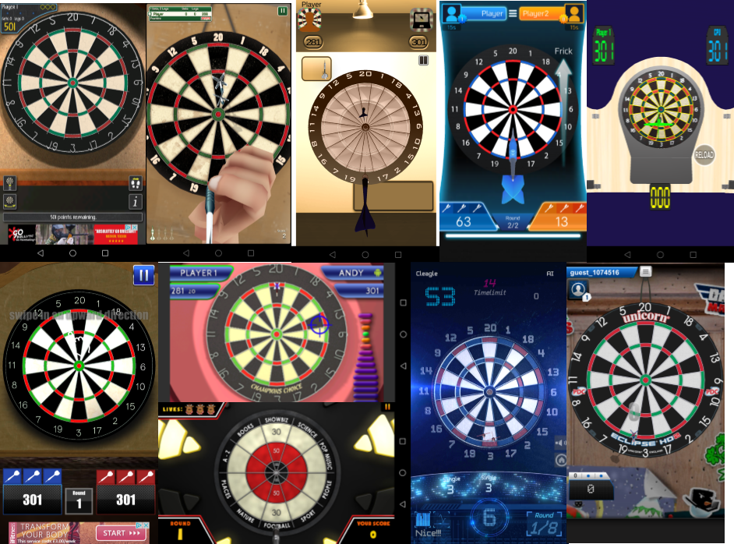
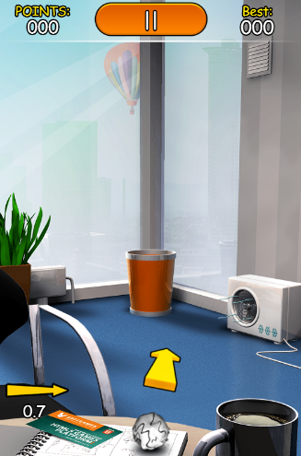
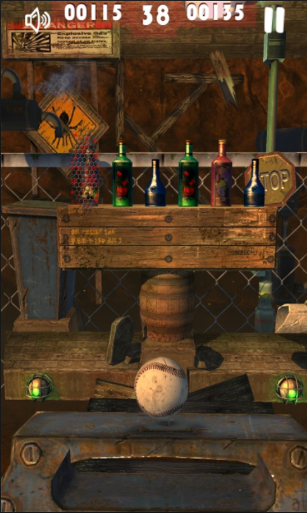
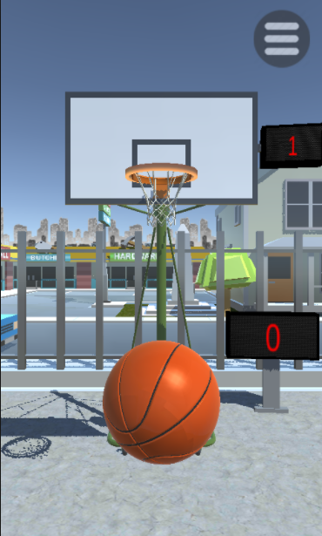
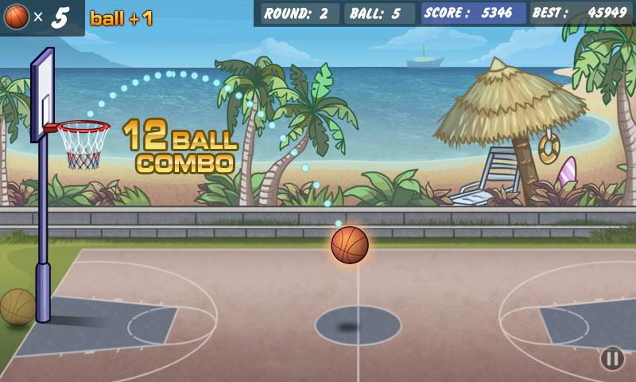
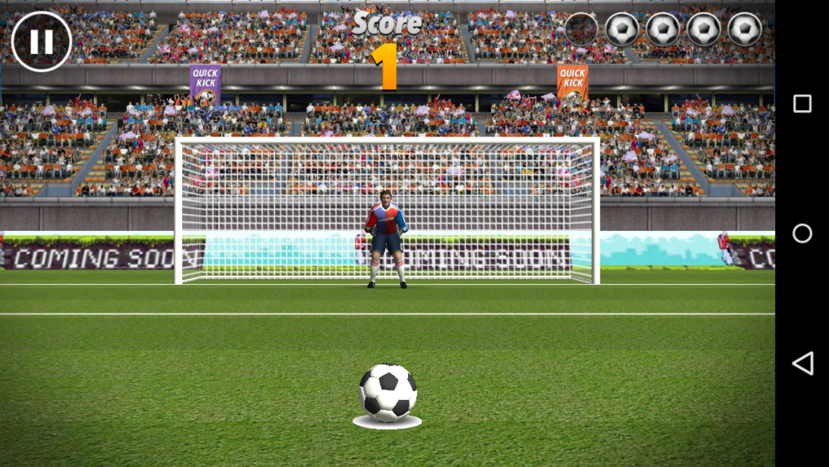
MoodBoards
Notes:
Left MoodBoard: This board shows multiple games that I looked at and played, a few of them use very similar styles and designs but a couple stand out with different styles, such as the futuristic and technology based looks, I think these are really interesting as they are basic and yet they stand out from the rest with their choice of colour. All the other games tend to use the same colour scheme and board. The other exception is the one that looks quite washed out and not very appealing, it’s very de-saturated.
Right MoodBoard: The board on the right is a few games that I looked at for inspiration, they’re all similar in one aspect and that is that they’re all about aiming and throwing a ball at a target or trying to get it into a container. These are good ideas since they’re easy to play and can have a one press mechanic easily put into the game as an aiming feature so you need to aim the object and tap when it’s in the right area, some aspect of these games I like are the wind mechanics and other obstacles that might get in the way, these are also good two player games since the players can take it in turns to throw one object each and whoever gets the higher score at the end wins.

Slide 3
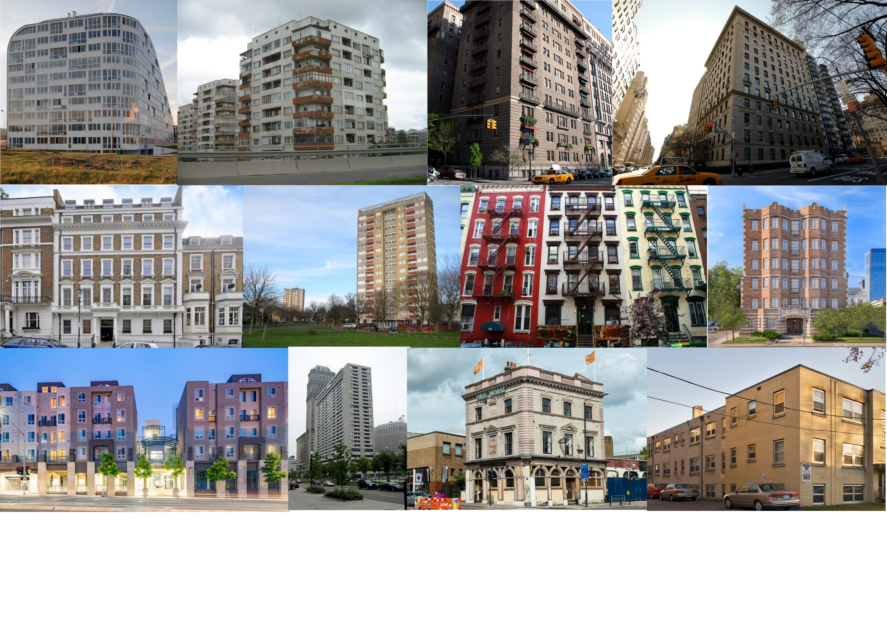
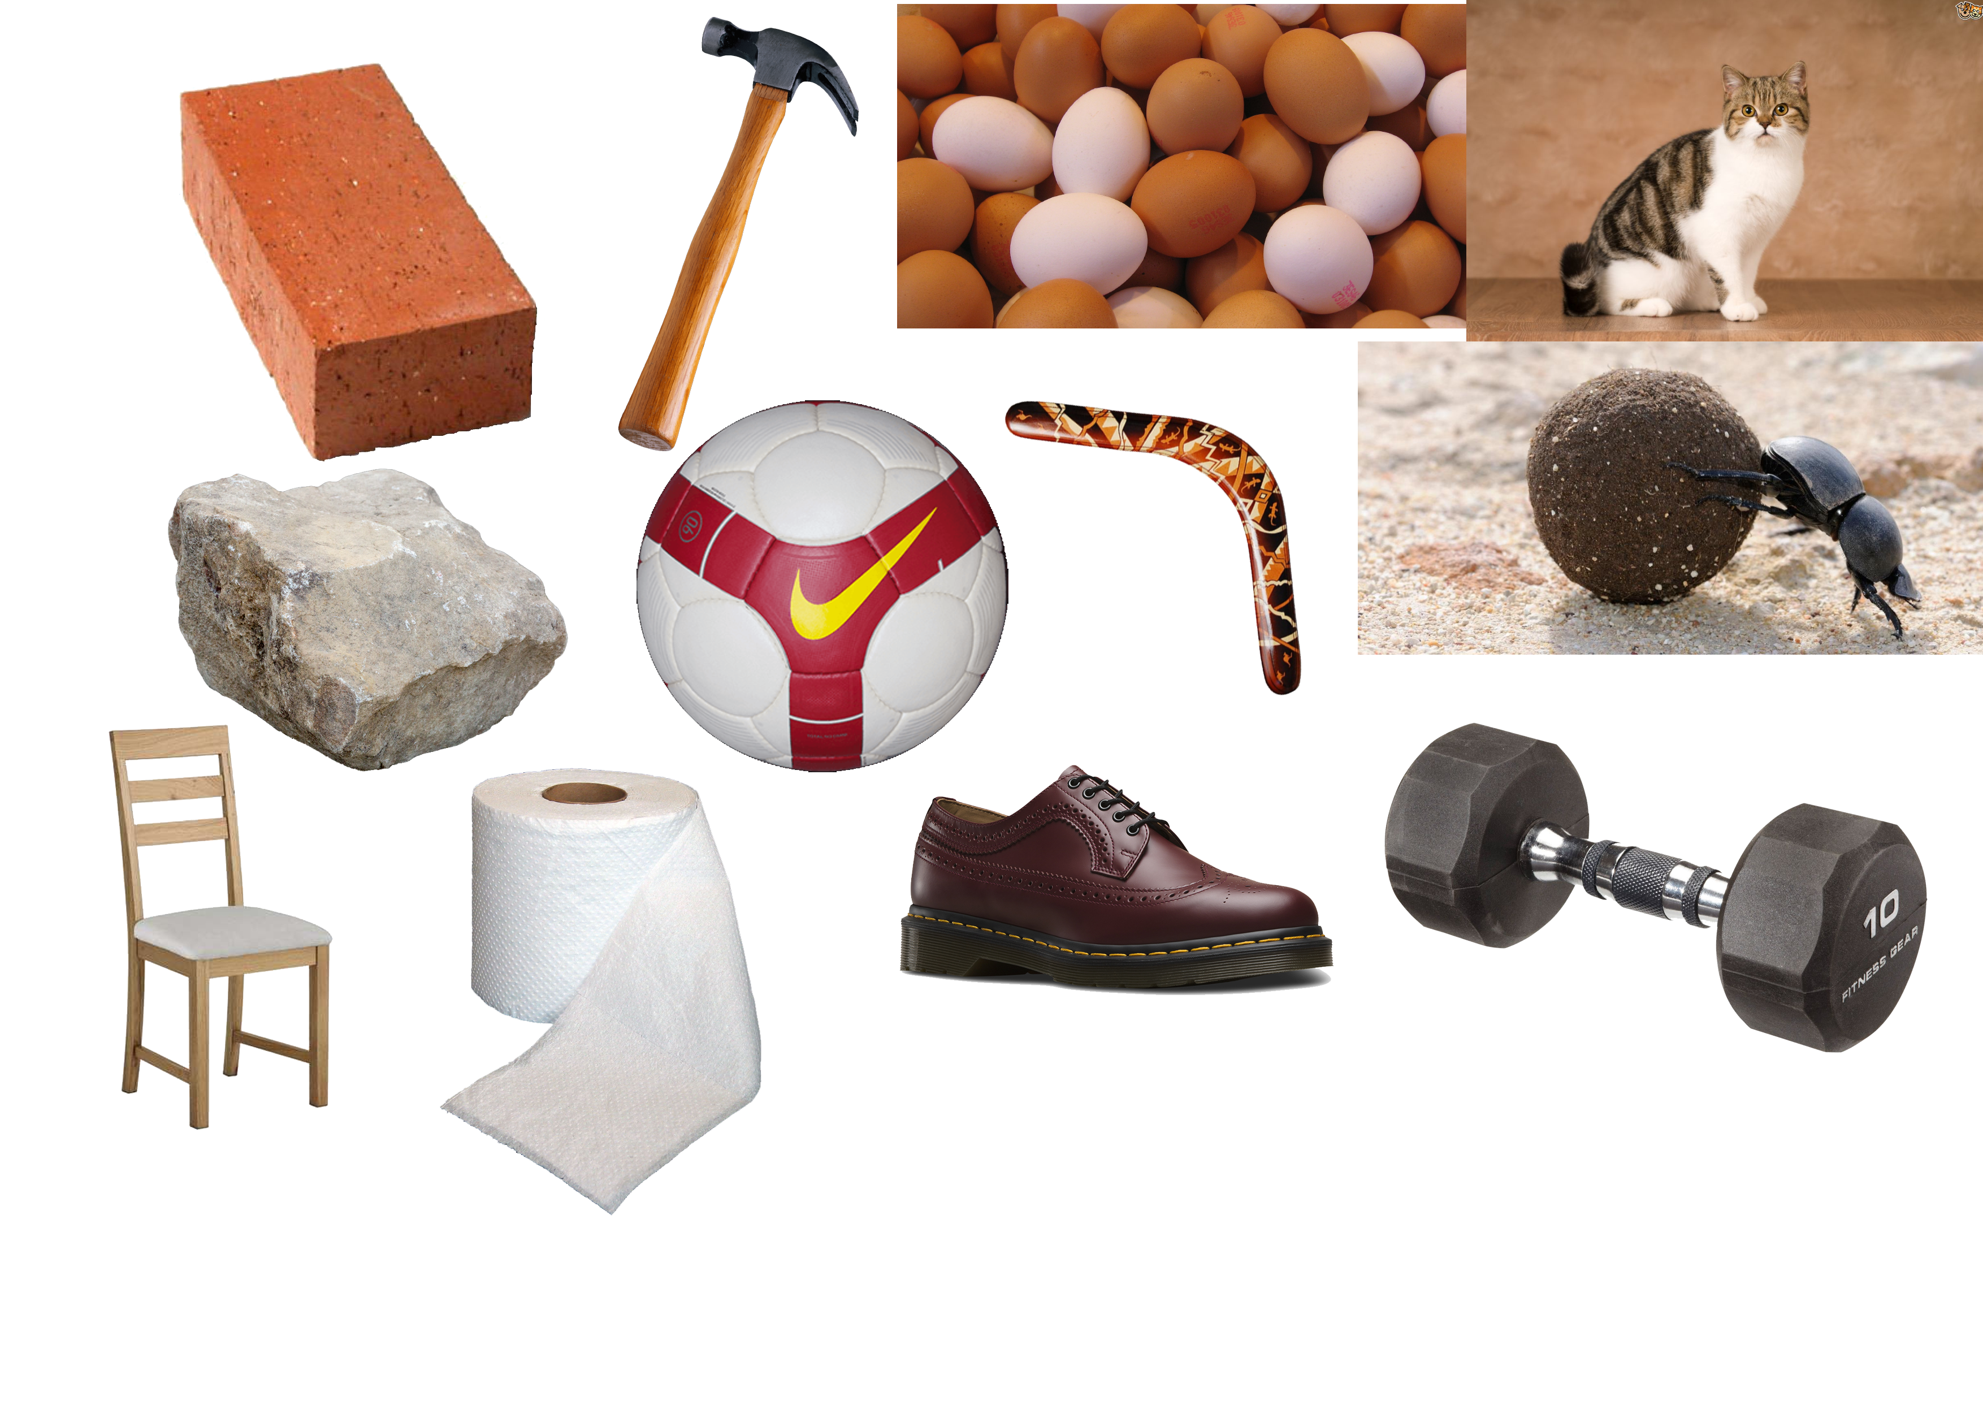
MoodBoards
Notes:
Left Board: This board is showing a variety of different items that can be used in the game to smash the windows and they all vary in weight and size going from toilet roll and shoes to Dumbells and chairs. I was thinking that these could be implemented into the game as options for players to pick from that would make it harder to throw or easier to throw depending on the item. Some items might even score bonus points if thrown at a window before another one (For example, throwing an egg at a window will “mark it” and smashing that window on your next turn would give you bonus points.
Right Board: This board is all different types of apartment blocks, I tried to look for apartments that have a lot of windows and also vary in location. The change in Windows would make the games difficulty also change since there would be more or less targets depending on the type of building chosen by the players. The location could also be good to look into as certain players might enjoy playing in locations that they find familiar such as London or New York.

